Slide 1

Mini-Project [Python]
TITLE : Loan Dataset
Submitted by : Nivedhitha R

Slide 2
Problem Definition
Dataset : loan.csv
Problem Statement : To identify variables which indicate if a person is likely to default, which can be used for identifying the risky loan applicants to avoid any financial loss to the company

Slide 3
Data Set Description
The dataset contains the complete loan data for all loans issued through the time period 2007 to 2011
annual_inc - The self-reported annual income provided by the borrower during registration
dti - A ratio calculated using the borrower’s total monthly debt payments on the total debt obligations, excluding mortgage and the requested LC loan, divided by the borrower’s self-reported monthly income
emp_length - Employment length in years. Possible values are between 0 and 10 where 0 means less than one year and 10 means ten or more years

Slide 4
Data Set Description
funded_amnt - The total amount committed to that loan at that point in time.
funded_amnt_inv - The total amount committed by investors for that loan at that point in time
grade - LC assigned loan grade 7.id - A unique LC assigned ID for the loan listing
id - A unique LC assigned ID for the loan listing
installment - The monthly payment owed by the borrower if the loan originates
int_rate - Interest Rate on the loan

Slide 5
Data Set Description
last_pymnt_amnt - Last total payment amount received
last_pymnt_d - Last month payment was received
loan_amnt - The listed amount of the loan applied for by the borrower. If at some point in time, the credit department reduces the loan amount, then it will be reflected in this value
loan_status - Current status of the loan
member_id - A unique LC assigned Id for the borrower member
purpose - A category provided by the borrower for the loan request

Slide 6
Data Set Description
term -The number of payments on the loan. Values are in months and can be either 36 or 60
total_acc - The total number of credit lines currently in the borrower's credit file
total_pymnt - Payments received to date for total amount funded
total_pymnt_inv - Payments received to date for portion of total amount funded by investors
total_rec_int - Interest received to date

Slide 7

Project Flow – Question 1
Import the dataset and understand it
•
The above function is used to read and load data from a Comma- Separated Values (CSV) file into the Pandas DataFrame df

Slide 8
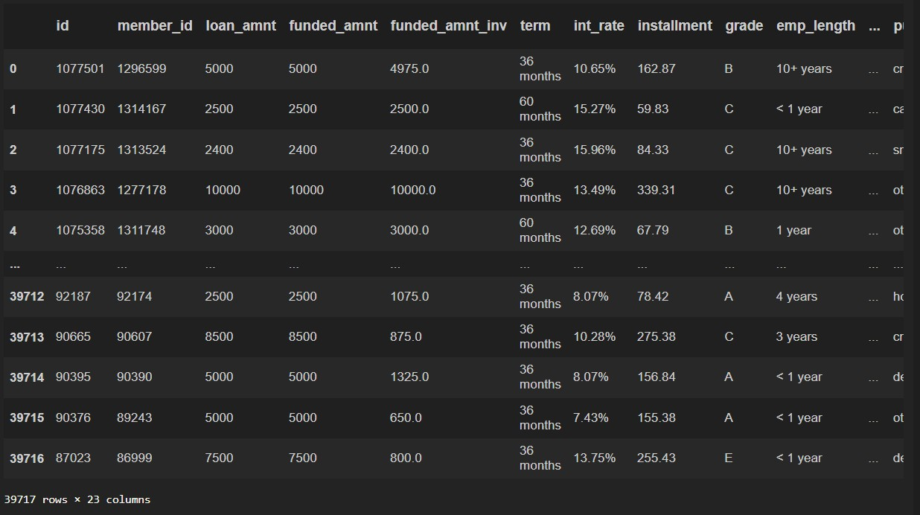

Slide 9
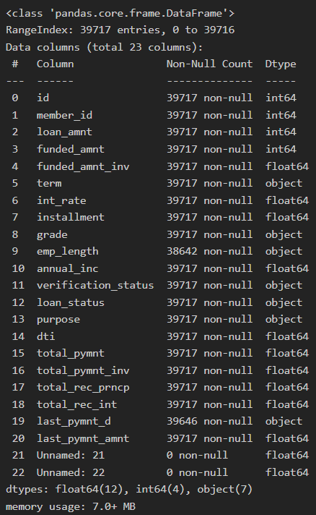

Project Flow – Question 2
List down the number of rows and columns
•
Info() provides all the information about the DataFrame
Inference:
Number of columns = 23 Number of rows = 39717
•
•
•

Slide 10
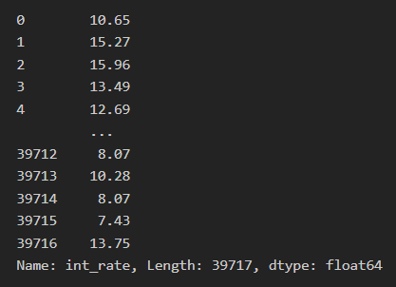
Project Flow – Question 3
‘Int_rate’ column is character type. With the help of lambda function convert into float type
•
apply() function is used along with lambda function with a condition to convert ‘int_rate’ column into float datatype
Inference – ‘int_rate’ converted into float datatype
•

Slide 11
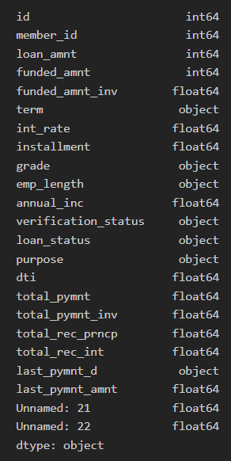

Project Flow – Question 4
Check the datatype of each column
•
The above code having ‘dtypes’ attribute returns a series with column names as the index and the corresponding data types as the values

Slide 12
Project Flow – Question 5
Cleaning the dataset- Remove the columns having complete NaN value in the entire dataset
•
Here dropna() drops columns with any missing values (NaN) and stores into a new DataFrame called df1 that contains only the columns without missing values.
Inference – Two columns having missing values (column number changed from 23 to 21)
•

Slide 13
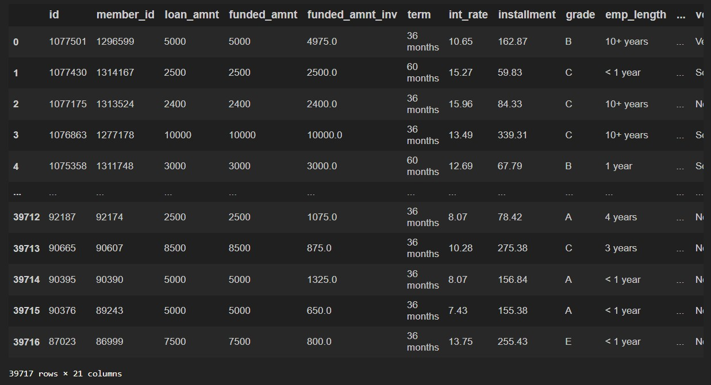

Slide 14
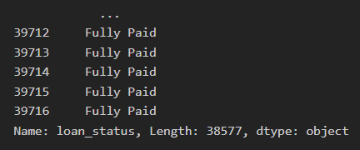
Project Flow – Question 6
Write the code to find the value counts of the ‘loan_status’ category column and filter only the ‘fully paid’ and ‘charged off’ categories
•
Created a Boolean Series that indicates whether each element in the 'loan_status' column is equal to 'Fully Paid’ or ‘Charged Off’
•
Returns the rows which satisfies the condition, the Solution
Inference – 38577 entries with ‘loan_status’ either ‘Fully Paid’ or ‘Charged off’
•

Slide 15
Project Flow – Question 7
Filter the ‘Emp_Len’ column to extract the numerical value from the string
•
Above code extracts numerical values from the 'emp_length' column using the regular expression \d+, which matches one or more digits
•
Inference – numerical values were extracted from ‘emp_length’ and replaced ‘emp_length’ column with the extracted values

Slide 16
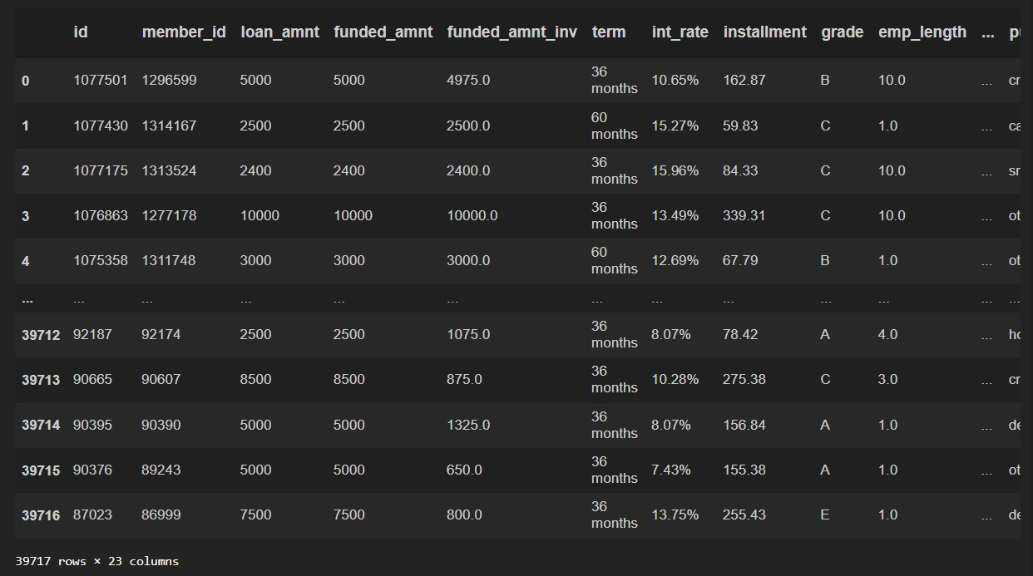

Slide 17
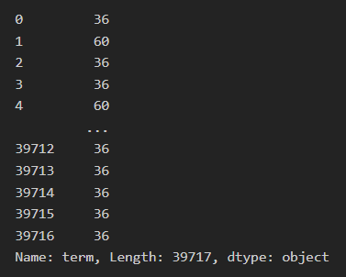
Project Flow – Question 8
Using the Lambda function, remove the month from the ‘term’ column such that ‘36 months’, ‘60 months’ appear as 36 and 60 respectively
•
apply() function is used along with lambda function with a strip condition to trim the term ‘months’ from the rows
•
Inference – ‘term’ column changed as shown

Slide 18
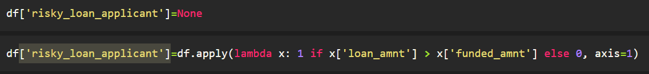
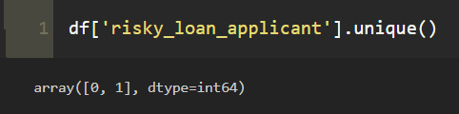
Project Flow – Question 9
Create a new column as risky loan applicant by comparing loan_amnt and funded_amnt with the following criteria - If loan_amnt is less than equals to funded_amnt set it as ‘0’ else set it as ‘1’
•
apply() function is used along with lambda function with an if else statement as shown to change the values to 0 and 1 accordingly
Inference – Rows were changed to zeros and ones
•

Slide 19
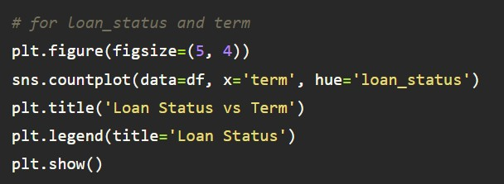
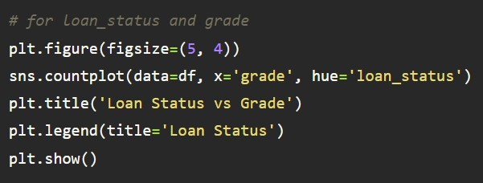
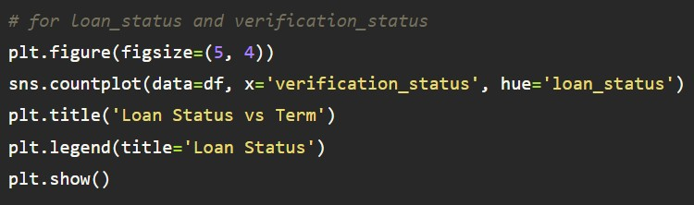
Project Flow – Question 10
Using the bar plot visualize the loan_status column against categorical column grade, term, verification_status. Write the
observation from each graph
Function used to plot barplot – sns.countplot
•

Slide 20
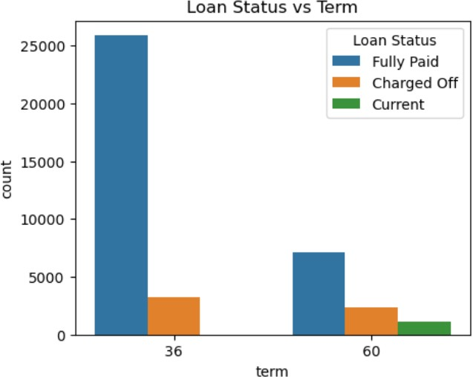
Loans with a term of '36
months' proportion
have a higher of 'Fully
paid'
'60
loans compared to
months'.
The number of 'Fully Paid' loans is higher for both term options.
Loans with term '60 months' have loans which are in 'current' condition

Slide 21
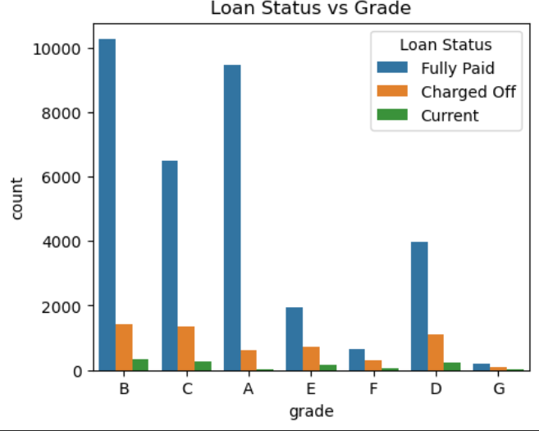
Grade 'B' has the highest number of 'Charged Off' loans compared to other grades.
Grade 'B' has the highest number of 'Fully Paid' loans folled by Grade 'A'.

Slide 22
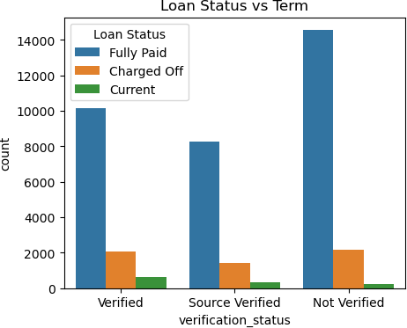
Loans with 'Not Verified' verification status have a higher proportion of 'Fully Paid' loans.
Loans w ith ' Ve r ifie d' verification status have higher 'charged off' and 'current' loan status.
Loans with 'Not Verified' verification status have lowest 'current' loan status

Slide 23
Project Flow – Question 11
Using a user defined function convert the ‘emp_len’ column into categorical column as follows -
•
•
•
•
•
If emp_len is less than equals to 1 then record as ‘fresher’
If emp_len is greater than 1 and less than 3 then record as ‘junior’ If emp_len is greater than 3 and less than 7 then record as ‘senior’ If emp_len is greater than 7 then record as ‘expert’
Inference – if available

Slide 24
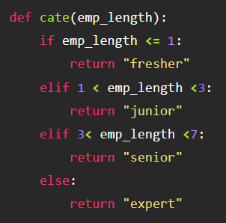

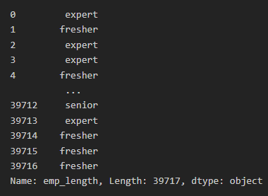

Slide 25
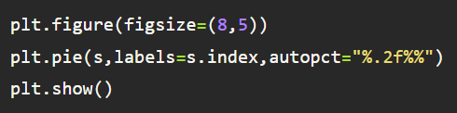
Project Flow – Question 12
Find the sum of ‘loan_amnt’ for each grade and display the distribution of ‘loan_amnt’ using a pie plot
•
To finding sum, groupby() function is used to find sum of ‘loan_amt’ with respect to ‘grade’ using the aggregate function sum()
•
Function used to plot pie chart – plt.pie

Slide 26
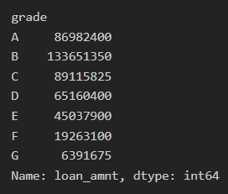

Slide 27
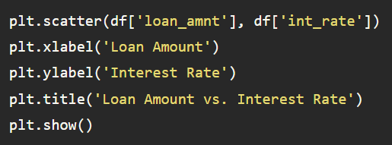
Major Challenge – Question 1
What is the relationship between loan amount and interest rate?
•
To find relationship between two numeric data, scatterplot is plotted

Slide 28
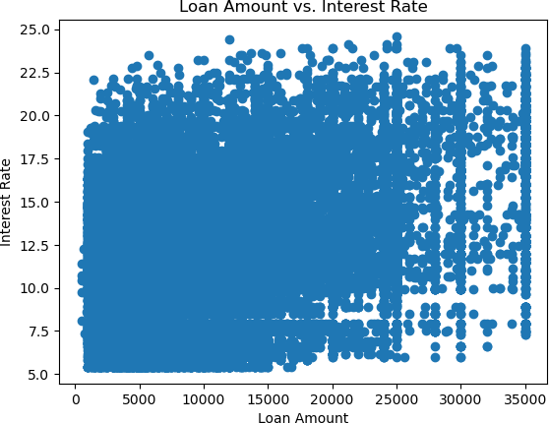
Inference – The relationship among
Loan amount and interest rate are dsense till the loan amount of 25,000

Slide 29
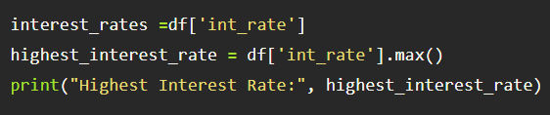

Major Challenge – Question 2
What is the highest interest rate in the dataset?
•
The aggregate function max() is used to find maximum of ‘int_rate’
•
Inference – Highest Interest Rate is found to be 24.59%

Slide 30
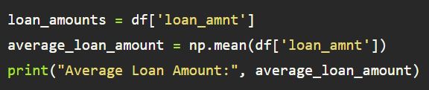

Major Challenge – Question 3
What is the average loan amount funded across all loans?
•
The aggregate function avg() is used to find average of ‘int_rate’
•
Inference – The average loan amount is found to be 11219.44

Slide 31
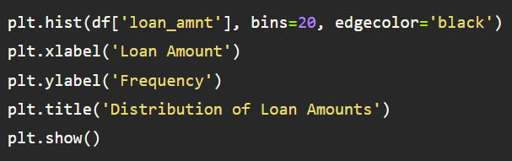
Major Challenge – Question 4
How does the distribution of loan amounts look?
To find distribution of numeric data, histogram is plotted

Slide 32
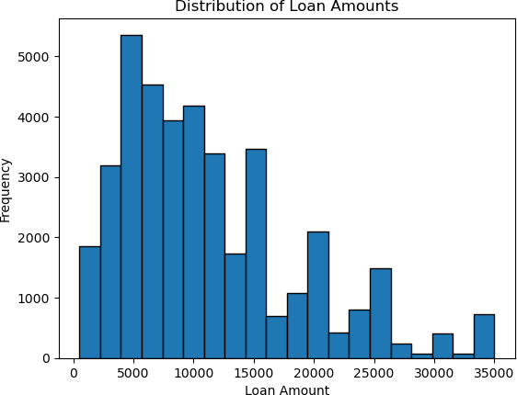
Inference – The highest distributed loan amount is to be around range of 5000 and the lowest distributed loan amount is to be around range of 30000..

Slide 33
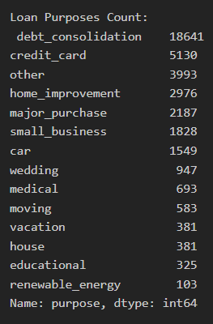

Major Challenge– Question 5
How many loans were taken for different loan purposes?
•
Value_counts function is used to count the ‘purpose’ column
Inference – Counts of each unique values in ‘purpose’ column is generated with ‘debt_consolidation’ having highest count
•

Slide 34
Conclusions
Write the lessons learned
Data Exploration: The first step in any data analysis project is to thoroughly explore the dataset. This helps in understanding its structure, variables, and identifying potential issues.
Data Cleaning: Data cleaning is crucial. Handling missing values, duplicates, and outliers ensures the dataset's integrity and improves the accuracy of subsequent analyses.
Data Visualisation: Data visualisation plays a vital role in understanding the data more intuitively. Visualisations like histograms and line plots help in identifying trends, patterns, and outliers.

Slide 35
Skills used
1. Data Cleaning and Preprocessing:
•
Handling missing data: Using techniques like imputation or removal of missing values to ensure data
completeness.
•
•
Dealing with duplicates: Identifying and removing duplicate records to maintain data integrity.
Outlier detection: Identifying and addressing outliers that might skew analysis results.
2.
Data Exploration:
•
•
Understanding dataset structure: Examining data types, columns, and general structure.
Data summarization: Using methods like .info(), .describe(), and .value_counts() to gain insights
into the data.
3.
Data Visualization:
•
Matplotlib and Seaborn: Creating visualizations such as histograms, line plots, and bar charts to explore data
patterns.
•
Visualization libraries: Leveraging Python libraries for data visualization to present findings effectively.

Slide 36
Descriptive Statistics:
4.
•
Calculating summary statistics like mean, median, and standard deviation to understand data characteristics.
5. Data Handling Libraries:
•
•
Using Pandas for data manipulation and transformation.
NumPy for numerical computations and array operations.
6. Project Documentation and Reporting:
•
•
•
Writing clear and concise code comments.
Creating project documentation to explain the analysis process and results.
Communicating findings effectively through reports or presentations.
7.
Domain Knowledge:
•
Understanding the lending industry and loan-related concepts, such as credit scores, interest rates, and loan
terms.

Slide 37
Domain understanding developed
1. Loan Parameters:
•
•
•
loan_amnt: The principal amount of the loan applied for, indicating the initial loan size.
funded_amnt: The actual amount funded to the borrower, which may be lower than the requested amount.
funded_amnt_inv: The total amount committed by investors for that loan.
Loan Term:
term: The duration of the loan, typically expressed as the number of months
Interest Rate:
int_rate: The annual interest rate for the loan, expressed as a percentage.
Loan Installment:
installment: The monthly installment amount to be paid by the borrower, including both principal and interest.
Loan Grade:
grade: A risk classification assigned to the loan, often based on the borrower's creditworthiness.
Employment Length:
emp_length: The length of time the borrower has been employed, which can impact loan approval and terms.

Slide 38
7. Borrower’s Income:
•
annual_inc: The borrower's annual income, a crucial factor in assessing their ability to repay the loan.
8.
Verification Status:
•
verification_status: Indicates whether the borrower's income and other information have been verified
by the lending institution.
9.
Loan Status:
•
loan_status: Describes the current status of the loan, such as "Approved," "Defaulted," or "Fully Paid."
10.
Loan Purpose:
•
purpose: The reason for which the loan is taken, such as debt consolidation, home improvement, or
medical expenses.
11.
Debt-to-Income Ratio:
•
dti: The borrower's debt-to-income ratio, representing their ability to manage debt based on income.

Slide 39
12. Loan Repayment Metrics:
•
•
•
•
total_pymnt: The total amount paid by the borrower over the life of the loan.
total_pymnt_inv: The total amount paid by the borrower, considering any investments made by others.
total_rec_prncp: The total principal amount received by the lending institution.
total_rec_int: The total interest amount received by the lending institution.
13.
Last Payment Information:
•
•
last_pymnt_d: The date of the last payment made by the borrower.
last_pymnt_amnt: The amount of the last payment made by the borrower.
14.
Unnamed Columns:
•
Unnamed: 21 and Unnamed: 22: These columns appear to be unnamed or contain unspecified data.

Slide 40
Thank You !!!....

